Slide 1

Economics Course Code:CSER-1209
Md. Rabiul Karim
Assistant Professor
Department of Economics
Jagannath University, Dhaka
Email: rabiulkarimjnu@gmail.com

Slide 2
Utility
Utility denotes satisfaction. More precisely, it refers to how consumers rank different goods and services. If basket A has higher utility than basket B for a consumer, this ranking indicates that this consumer prefers A over B.
Utility is a measure of preferences over some set of goods.
The total satisfaction derived from the consumption of goods or services.

Slide 3
Cardinal Utility Analysis and Ordinal Utility Analysis
Utility Analysis
Cardinal Utility analysis
Ordinal Utility Analysis
Alfred Marshal
Can be measured
Law of Diminishing Marginal Utility
Law of Equi-marginal Utility
J. R. Hicks & R.G.D. Allen
Cannot be measured but compared as rank
Indifference Curve analysis

Slide 4
Concepts of Cardinal and Ordinal Utility
Cardinal Utility: The numbers 1, 2, 3, 4 are cardinal numbers. For example the number 2 is twice the size of 1. In the same way, the number 4 is four times the size of number 1. Alfred Marshall developed cardinal utility analysis. According to cardinal approach, utility can be measured.
Ordinal Utility: The numbers 1st, 2nd, 3rd, and 4th, are ordinal numbers. These ordinal numbers are ranked or ordered. This ranking does not explain the actual size relation of the numbers. Hicks and Allen used ordinal utility approach for analyzing the consumer behavior. It cannot be measured but rank.

Slide 5
Concept of Total Utility (TU) and Marginal utility (MU)
Total utility is the total satisfaction received from consuming a given total quantity of a good or service
The expression Marginal is a key term in economics and always means additional or extra.
Marginal Utility denotes the additional or extra satisfaction yielded from consuming one additional unit of a commodity, with amounts of all other goods consumed held constant.

Slide 6
Law of diminishing marginal utility
The law states that as the amount of a good consumed increases, the marginal utility of that good tends to diminish.
In other words, this law states that the amount of extra or marginal utility declines as a person consumes more and more of a good.
Reason behind this law
Utility tends to increase as you consume more of a commodity. This law states that as you consume more and more, your total utility will grow at a slower rate.

Slide 7
Assumptions:
Tastes, preferences, etc. of the consumer remain constant
Income of the consumer also remain constant
Units of the goods are identical or similar
Units of the goods are not very small in size
The process of consumption is continuous

Slide 8
Example
Suppose a person is thirsty and the price of water is zero. He takes one glass of water which gives him great satisfaction. We can say the first glass of water has great utility for him.
He then takes second glass of water. The utility of the second glass of water is less than that of first glass of water. The utility declines because the edge of his thirst has been blunted to a great extent.
If he drinks third glass of water, the utility of the third glass will be less than that of second and so on. The utility goes on diminishing with the consumption of every successive glass of water till it drops down to zero.
It is the position of consumer’s equilibrium or maximum satisfaction.
If the consumer is forced further to take a glass of water, it leads to disutility causing total utility-to decline. The marginal utility will become negative. A rational consumer will stop taking water at the point at which marginal utility becomes negative even if the good is free.
In short, when a good is free, a consumer increases consumption of a good so long its additional units provide him positive marginal utility.

Slide 9
The following table will make the law of diminishing marginal utility more clear.
Units | Total Utility | Marginal Utility
1st glass | 20 | 20
2nd glass | 32 | 12
3rd glass | 40 | 8
4th glass | 42 | 2
5th glass | 42 | 0
6th glass | 39 | –3

Slide 10
From the above table,
It is clear that in a given span of time :-
The first glass of water to a thirsty man gives 20 units of utility.
When he takes second glass of water, the marginal utility goes down to 12 units.
When he consumes fifth glass of water, the marginal utility drops down to zero and if the consumption of water is forced further from this point, the utility changes into disutility (–3).

Slide 11
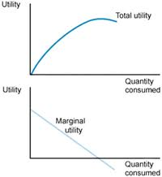
Relation between TU & MU

Slide 12
In the above figure,
OX we measure units of a commodity consumed and OY is shown the marginal utility derived from them. The marginal utility of the first glass of water is called initial utility. It is equal to 20 units. The MU of the 5th glass of water is zero. It is called the satiety point. The MU of the 6th glass of water is negative –3.
Tie MU curve here lies below the OX axis. The utility curve MM falls from left down to the right showing that the marginal utility of the success units of glasses of water is falling.
When a good is scarce and so priced the consumer will increase the consumption of a commodity up to the extent where his marginal utility for the good equals the price which he has to pay, i.e. Mu = P.

Slide 13
Limitations of the law
The unit of consumer good must be standard one
The consumer’s taste or preference must remain the same during the period of consumption
There must be continuity in consumption
The mental condition of the consumer must remain normal during the period of consumption

Slide 14
Indifference Curve
Indifference curves represent all combinations of market baskets that provide the same level of satisfaction to a person.
An indifference curve shows the various combinations of commodity X and commodity Y which yield equal utility or satisfaction to the consumer.
A higher indifference curve shows a greater amount of satisfaction and a lower one, less satisfaction.

Slide 15
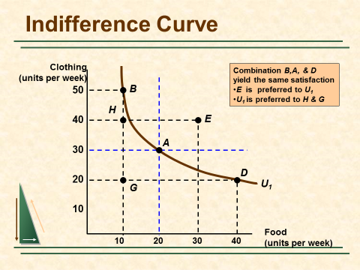

Slide 16
Properties of Indifference Curves
They are negatively sloped
They are convex to the origin
They cannot intersect.

Slide 17
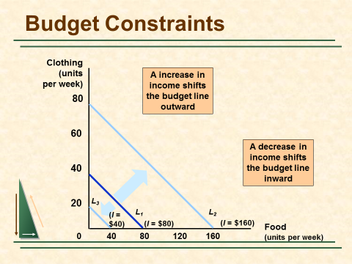
Budget Constraint Line
Budget constraint line shows all the different combinations of the two commodities that a consumer can purchase, given his or her money income and the prices of the two commodities.
M= PxX + PyY
Here,
M= Income
P = Prices of given commodity.
X, Y = Amount of
purchase of two commodity.

Slide 18
Consumer Equilibrium
A consumer is in equilibrium when, given personal income and price constraints, the consumer maximizes the total utility or satisfaction from his or her expenditures.
A consumer is in equilibrium when, given his or her budget line, the person reaches the highest possible indifference curve.
Indifference curve will tangent with budget constraint line.

Slide 19
Consumer Equilibrium
Clothing
(units per
week)
Pc = $2 P_{f} = $1 I = $80
At market basket A
the budget line and the
indifference curve are
tangent and no higher
level of satisfaction
can be attained.
40
30
A
20
At A:
MRS =P_{f}/P_{c} = .5
U₂
Budget Line
0
20
40
80
Food (units per week)
Notes:
78

Slide 20
Consumer Equilibrium
IC1 is not possible because here utility can not maximize
IC3 is no possible because of budget constraint
IC2 is possible because indifference curve is tangent with budget constraint

Slide 21
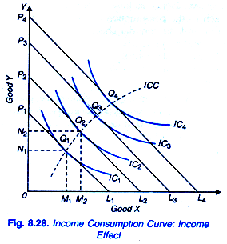
Income-Consumption Curve –ICC and the Engle Curve
It is the locus of points of consumer equilibrium resulting when only the consumer’s income is varied
Engle curve shows the amount of a commodity that the consumer would purchase per unit of time at various levels of total income.

Slide 22
Thanks

